Slide 1
Music App
By: Dominick Jones, Alexander Tolochkov, Joseph O’Such, Jaden Brown, Jack Golden, Jace Derderian

Slide 2
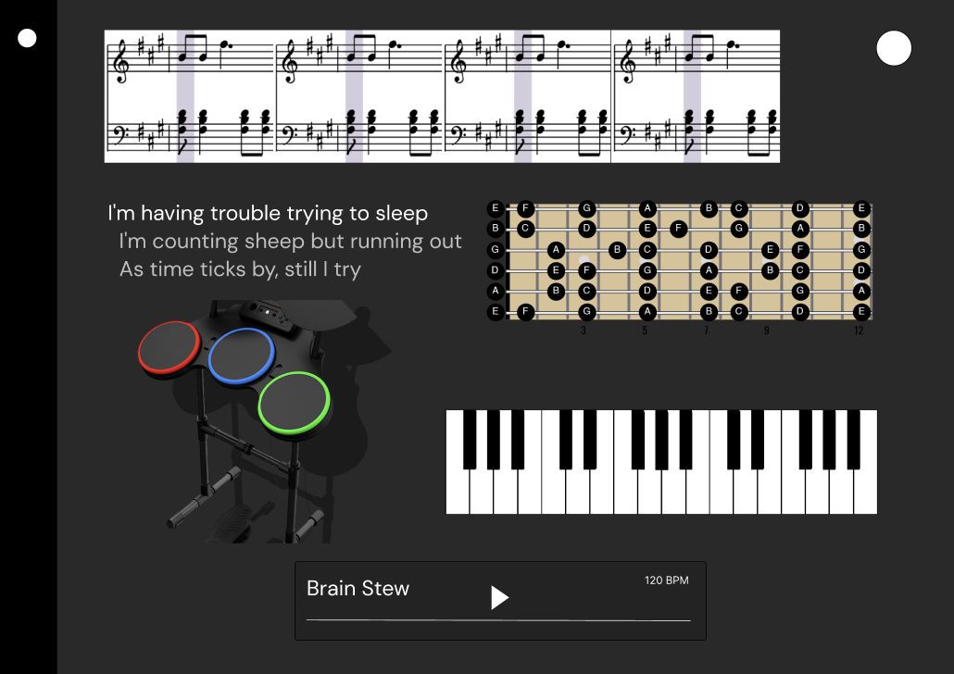
Intro
Description:
A web app for music students
Main Features:
Play along with music
Multiple instruments
Lyrics
Track your progress
Organize and share songs
Notes:
jack

Slide 3
Responsibilities
Each group member will be responsible for their own feature ideas
Each group member will complete the work designated to them

Slide 4
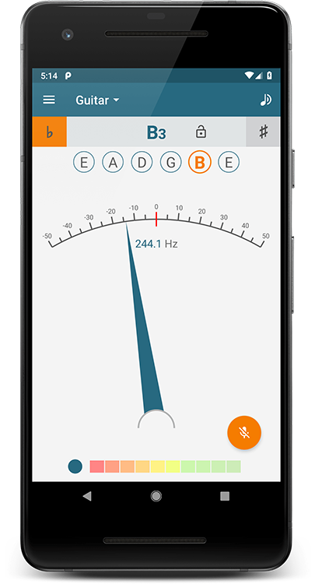
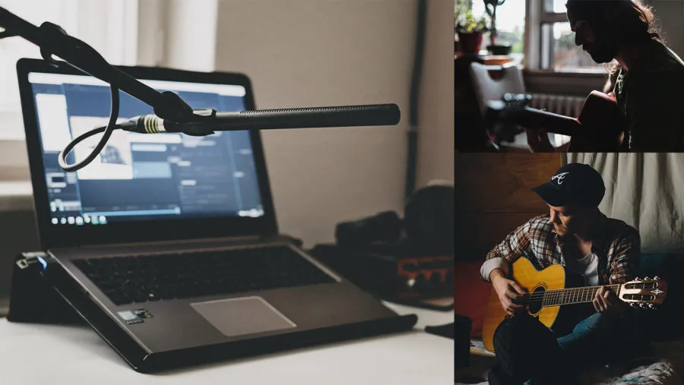

Features #1
In-app tuner.
Collaboration feature that allows you to connect with friends and play songs requiring more instruments.
Users can save and post covers of songs played in the app to be discovered by other users and creators.
Allow for connection to other apps such as spotify to automatically upload songs.
Passwords are hashed for website security.

Slide 5
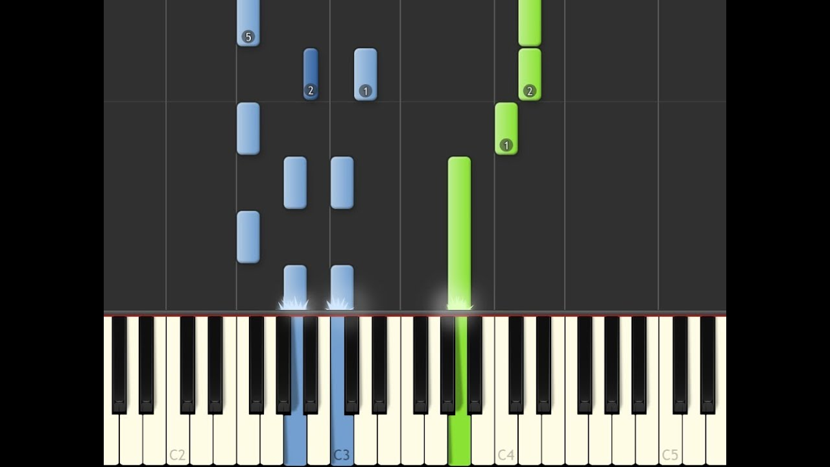
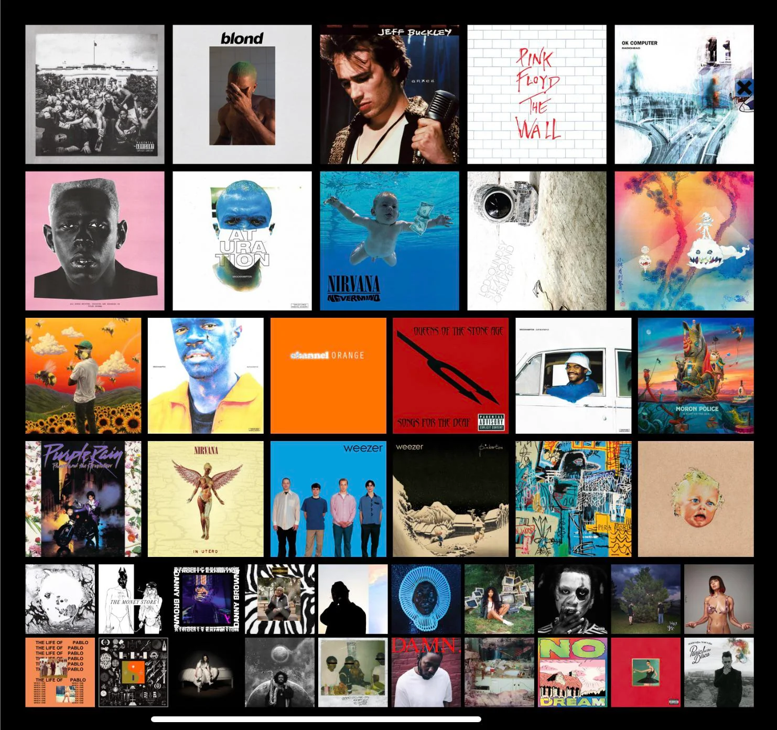
Features #2
Search for songs
Efficient DBMS for fast retrieval
Play songs
Support playback of common audio formats
Display songs on instruments (midi only)
Code should be maintainable & portable
Create a chart of your favorite songs
(Nonfunctional) minimalist design
Notes:
jack

Slide 6
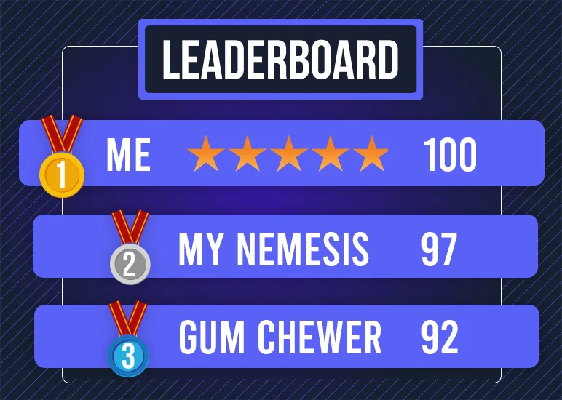
Features #3
User Profiles: Keep track of progress, saved songs, and remember preferences
Leaderboard: Compete with friends by completing songs
Feedback: Get real time feedback on your playing
Song Suggestion: Suggest songs you might like to learn
NFRQ - Easy to understand for beginner musicians

Slide 7

Features #4
List of supported instruments
Bug report feature
Custom background
Upload songs
Portability: compatible with all browsers
Chrome, edge, firefox, safari, etc…

Slide 8

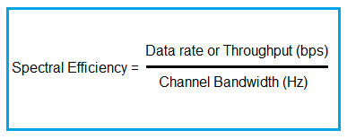
Features #5
Include a metronome to help users stay in rhythm. Users can also adjust the tempo to practice at their own pace
Provide interactive tutorials for beginners learning to play different instruments and gradually help improve their skills
Settings: Allow users to customize their user experience by adjusting settings like notifications, preference settings, langage, and social media integration.
Genre sort for song search function and saved songs where users can search for their song of choice and save them to create playlists
Non functional requirement: Responsiveness and Bandwidth Efficiency

Slide 9



Features #6
Users can change profile information including name, a picture, and bio.
Song difficulty rating: users can rate different songs on a 1 to 5 scale (like product rating online) based on how difficult the song is
Song enjoyment rating: users can rate different songs on a 1 to 5 scale (like product rating online) based on how much they enjoyed the song
Generate shareable link: generate a sharable link to your song recording
(Non-functional) - Must be a website

Slide 10
Challenges
Parsing MIDI files + displaying on instruments is difficult
Solution: Use pre-existing libraries (midi-player-js)
Handling lots of users on the site at one time and storing all that information
Solution: Keep scalability in mind when designing
Legal issues regarding using copyrighted material
Solution: work with record labels and artists to create a mutually beneficial agreement

